Slide 1
British Government

Slide 2
Content
General facts about the British government
The parliament
The government
Political parties

Slide 3
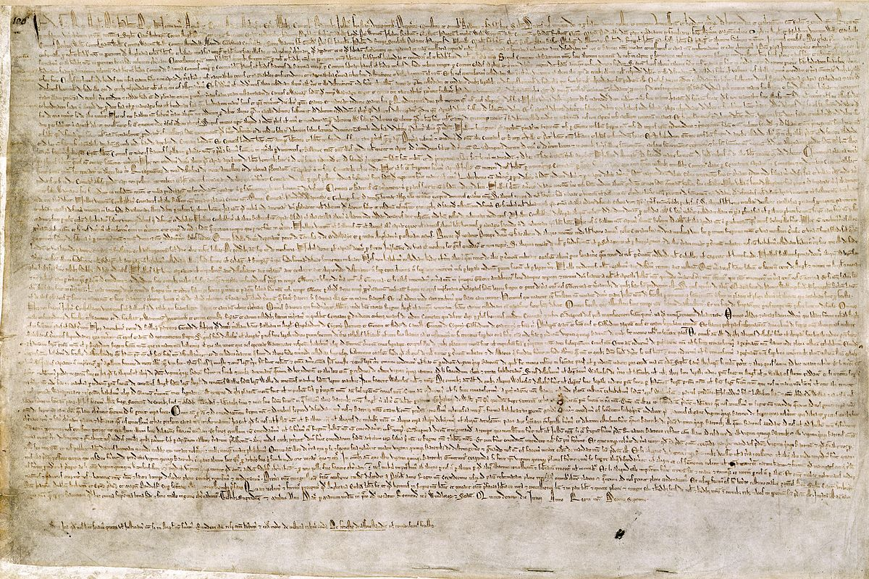
General facts
No written constitution
Magna carta
Monarch
Parliamentary democracy
Prime minister
Palace of Westminster

Slide 4
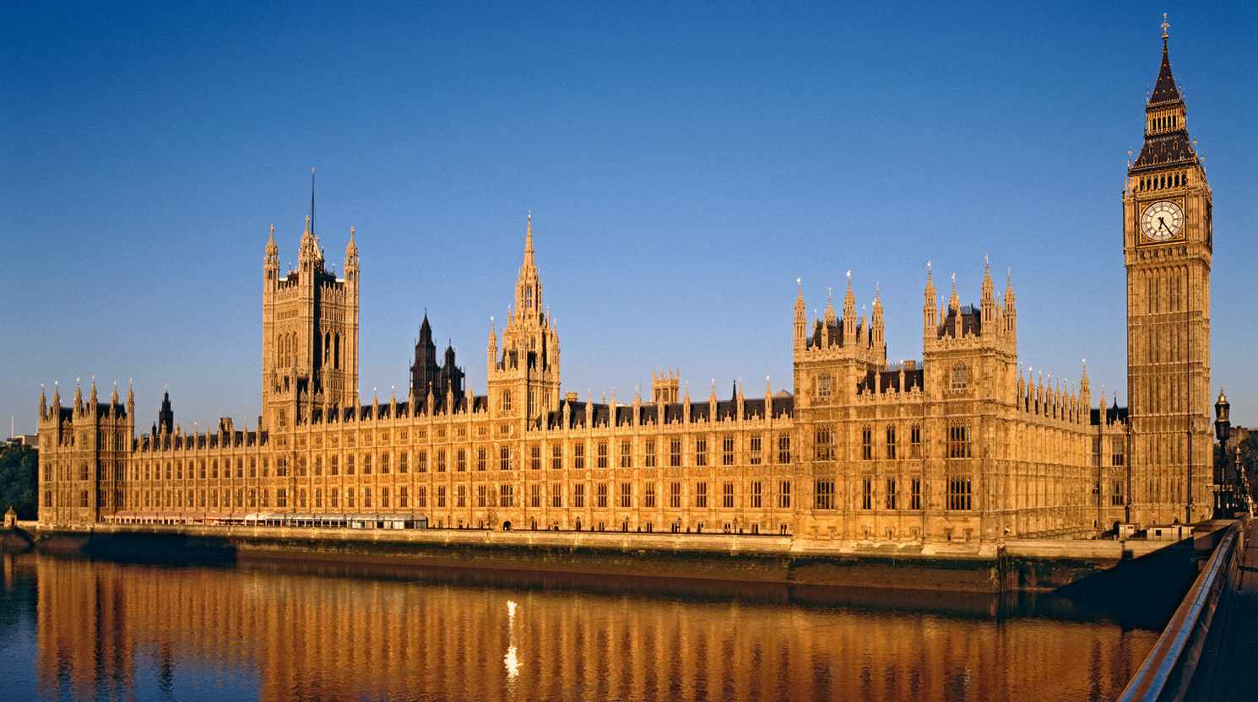
The parliament
Two houses
House of lords:
- Inherited power (Noble, Peer)
- Very little power
-Reject bills
House of commons:
- Political power
- Lawmaking

Slide 5

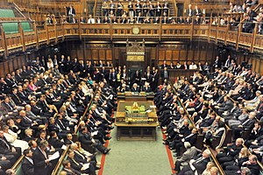
The parliament
- Constituencies
- MPs
- Prime minister and cabinet ministers
- Opposition party

Slide 6
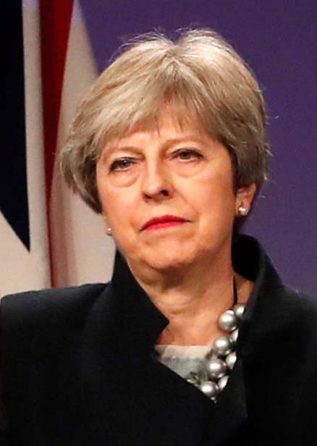
The government
Day-to-day basis
Legislations and budgets
Laws into effects
Conservative party
Theresa May

Slide 7
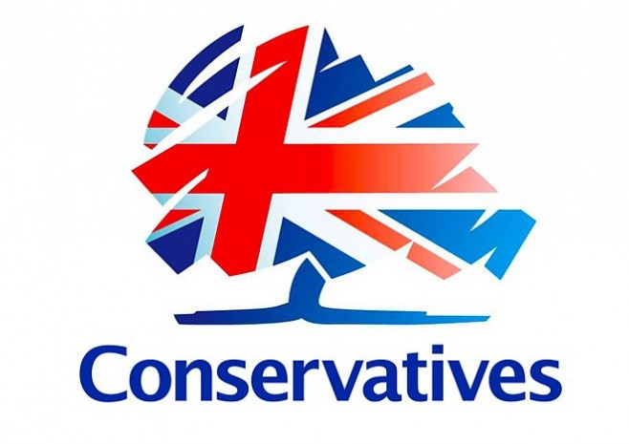

Political parties in the UK
10-12 parties
Conservative and labor
Conservative:
- Free economic market
- Private services
- Cut incom taxes
Labor party:
- More public services

Slide 8



Political parties
- Higher taxes
- Council homes
Other political parties are:
Scottish National Party (SNP)
The Liberal Democrats
The Greens

